Slide 1

BREAST CANCER PREDICTION
BREAST CANCER PREDICTION
By:
Aarushi sharma
Muskan Chhabra

Slide 2
BREAST CANCER: An Overview
Breast cancer is cancer that forms in the cells of the breasts.
Breast cancer can occur in both men and women, but it's far more common in women.
Breast cancer is one of the most common cancers among women, second only to skin cancer. It’s most likely to affect women over the age of 50.
In the United States, breast cancer is the second-leading cause of cancer death in women, after lung cancer. It’s also the leading cause of cancer death among women ages 35 to 54.
A women has about one in eight chance of being diagnosed with breast cancer in her lifetime, according to National Cancer Institute.
Most women who get breast cancer do not have family history of the disease.

Slide 3
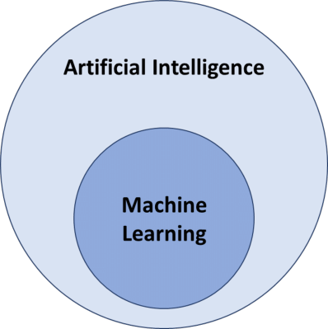
INTRODUCTION
What is Machine Learning and why we are using it?
Machine learning(ML) is a field of artificial intelligence (AI) that uses statistical techniques to give computer system the ability to “learn” from data. Through the use of statistical methods, algorithms are trained to make classifications or predictions.
Self thinking computer
Self thinking computer
Provides mathematical tool to AI

Slide 4
Objective
Objective of this project is to apply ML algorithms to classify breast cancer outcomes using a small publicly available data set.
To achieve this i have used machine learning classification methods to fit a function that can predict the discrete class of new input.
In addition, this study develops a breast cancer prediction platform.

Slide 5
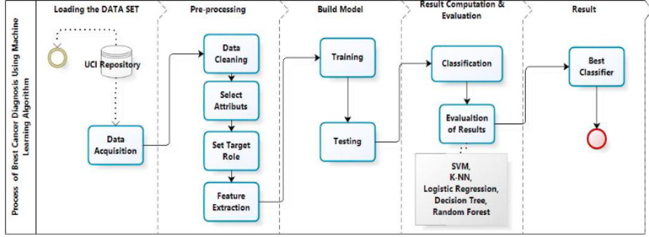
Methodology
The main objective of our experiment is to identify the effective and predictive algorithm for the detection ofbreast cancer, therefore we applied machine learning classifiers Support Vector Machine (SVM), Random Forests,Logistic Regression, Decision tree (C4.5), K-Nearest Neighbors (KNN) on Breast Cancer Wisconsin Diagnosticdataset and evaluate the results obtained to define which model provides a higher accuracy.

Slide 6
1.Dataset acquisition
Our methodology begins with data acquisition.
In our study, we use Breast Cancer Wisconsin Diagnostic dataset from University of Wisconsin Hospitals Madison Breast Cancer Database .breast cancer data includes 569 examples of cancer biopsies,each with 32 features. Breast Cancer Wisconsin Diagnostic has 569 instances (Benign: 357 Malignant:212), 2 classes (62.74% benign and 37.26% malignant), and 11 integer-valued attributes (-Id -Diagnosis -Radius -Texture -Area -Perimeter -Smoothness -Compactness -Concavity -Concave points -Symmetry -Fractal dimension).

Slide 7
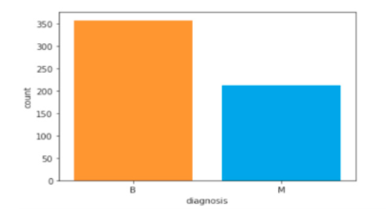

Slide 8
2. Pre- processing
After data acquisition , pre processing of data is done which involves four steps-Data cleaning,Select attributes,Select target role,Feature selection.
Missing or Null Data points
We can find any missing or null data points of the data set (if there is any) using the following pandas function.
Coverting categorical data to numerical
We will use Label Encoder to label the categorical data. Label Encoder is the part of SciKit Learn library in Python and used to convert categorical data, or text data, into numbers, which our predictive models can better understand.
dataset.isnull().sum() dataset.isna().sum()

Slide 9
The prepared data is used to build machine learning algorithms that can predict the breast cancer for a new set of measurements. To evaluate the algorithms performances, we show the model new data for which we have labels. This is usually done by splitting the labeled data we have collected into two parts whit Train_test_split method. The data we use is usually split into training data and test data. The training set contains a known output and the model learns on this data in order to be generalized to other data later on. We have the test dataset (or subset) in order to test our model’s prediction on this subset. We will do this using SciKit-Learn library in Python using the train_test_split method. Here,80% of the data is used to build our machinelearning model, and is called the training data or training set. 20% of the data will be used to access how well themodel works and is called test data, test set.

Slide 10
Feature scaling
Most of the times, your dataset will contain features highly varying in magnitudes, units and range. But since, most of the machine learning algorithms use Euclidian distance between two data points in their computations. We need to bring all features to the same level of magnitudes. This can be achieved by scaling. This means that you’re transforming your data so that it fits within a specific scale, like 0–100 or 0–1.
We will use StandardScaler method from SciKit-Learn library.

Slide 11
3. Model selection
This is the most exciting phase in Applying Machine Learning to any Dataset. It is also known as Algorithm selection for Predicting the best results.
Usually Data Scientists use different kinds of Machine Learning algorithms to the large data sets. But, at high level all those different algorithms can be classified in two groups : supervised learning and unsupervised learning.
Without wasting much time, I would just give a brief overview about these two types of learnings.
Supervised learning : Supervised learning is a type of system in which both input and desired output data are provided. Input and output data are labelled for classification to provide a learning basis for future data processing. Supervised learning problems can be further grouped into Regression and Classification problems.
A regression problem is when the output variable is a real or continuous value, such as “salary” or “weight”.
A classification problem is when the output variable is a category like filtering emails “spam” or “not spam”
Unsupervised Learning : Unsupervised learning is the algorithm using information that is neither classified nor labeled and allowing the algorithm to act on that information without guidance.
In our dataset we have the outcome variable or Dependent variable i.e Y having only two set of values, either M (Malign) or B(Benign). So we will use Classification algorithm of supervised learning.
We have different types of classification algorithms in Machine Learning :-
1. Logistic Regression
2. k-Nearest Neighbor
3. Support Vector Machines
4. Decision Tree Algorithm
7. Random Forest Classification
We will use sklearn library to import all the methods of classification algorithms.

Slide 12
Machine learning algorithms used:
Logistic regression
It is a supervised machine learning technique, employed in classification jobs (for predictions based on training data). Logistic Regression uses an equation like Linear Regression, but the outcome of logistic regression is a categorical variable whereas it is a value for other regression models. Binary outcomes can be predicted from the independent variables.
2. k-Nearest Neighbour (k-NN)
K-Nearest Neighbour is a supervised machine learning algorithm as the data given to it is labelled. It is a nonparametric method as the classification of test data point relies upon the nearest training data points rather than considering the dimensions (parameters) of the dataset.
Support Vector machine
Support Vector Machine is a supervised machine learning algorithm which is doing well in pattern recognition problems and it is used as a training algorithm for studying classification and regression rules from data. SVM is most precisely used when the number of features and number of instances are high. A binary classifier is built by the SVM algorithm. In an SVM model, each data item is represented as points in an n-dimensional space where n is the number of features where each feature is represented as the value of a coordinate in the n-dimensional space. Here's how a support vector machine algorithm model works: (1) First, it finds lines or boundaries that correctly classify the training dataset. (2) Then, from those lines or boundaries, it picks the one that has the maximum distance from the closest data points.

Slide 13
4. Decision tree Decision Tree is a predictive modeling tool that can be applied across many areas. It can be constructed by an algorithmic approach that can split the dataset in different ways based on different conditions 5. Random forest Random forest, like its name implies, consists of many individual decision trees that operate as an ensemble. Each individual tree in the random forest spits out a class prediction and the class with the most votes becomes our model’s prediction.

Slide 14
Model evaluation Results
Table 3. Model Type and Accuracy
Model type and accuracy
Model | Accuracy(%)
Decision tree | 92.98
Logistic regression | 60.52
K-NN | 79.82
SVM | 97.36
Random forest | 93.85
Interpretation: SVM model reached a 97.3% accuracy rate, with least number of fault predictions for breast cancer classification

Slide 15
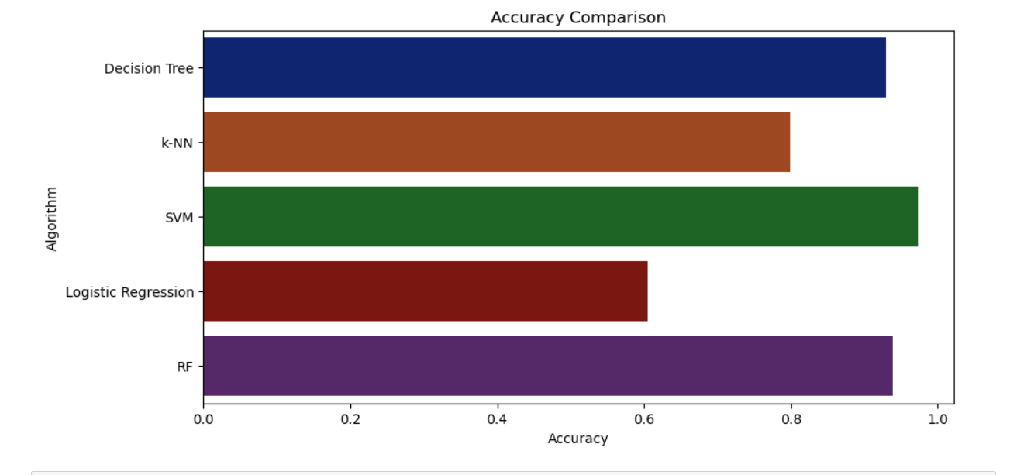
Accuracy comparison
Accuracy is most common performance metric for classification algorithms. It defined as the number of correct predictions made as a ratio of all predictions made.
Clearly , we can see that SVM and random forest has the highest accuracy.

Slide 16
Classification report
A classification report is a performance evaluation metric in machine learning. It is used to show the precision, recall, F1 Score, and support of your trained classification model.
Metrics | Definition
Precision | Precision is defined as the ratio of true positives to the sum of true and false positives.
Recall | Recall is defined as the ratio of true positives to the sum of true positives and false negatives.
F1 Score | The F1 is the weighted harmonic mean of precision and recall. The closer the value of the F1 score is to 1.0, the better the expected performance of the model is.
Support | Support is the number of actual occurrences of the class in the dataset. It doesn’t vary between models, it just diagnoses the performance evaluation process.

Slide 17
Confusion matrix
Confusion Matrix is the way to measure the performance of a classification problem where the output can be of two or more type of classes. A confusion matrix is a table with two dimensions viz. “Actual” and “Predicted” and furthermore, both the dimensions have “True Positives (TP)”, “True Negatives (TN)”, “False Positives (FP)”, and “False Negatives (FN)

Slide 18
Conclusion
On the Wisconsin Breast Cancer Diagnostic dataset (WBCD) we applied five main algorithms which are: SVM,Random Forests, Logistic Regression, Decision Tree, K -NN, calculate, compare and evaluate different results obtained based on confusion matrix, accuracy, classification report to identify the best machine learning algorithm that are precise, reliable and find the higher accuracy. All algorithms have been programmed in Python using scikit-learn library in Anaconda environment. After an accurate comparison between our models, we found that Support Vector Machine achieved a higher efficiency of 97.3%, Precision of 97.%, F-1 score of 98% and outperforms all other algorithms. In conclusion, Support Vector Machine has demonstrated its efficiency in Breast Cancer prediction and diagnosis and achieves the best performance in terms of accuracy and precision.

